Slide 1
Cinefly Audit 2 Presentation
By Jiawei Fan
Yuchen Wang
Yuliang Ma
Yimin Xu
Xiaoxiang Kong
Date: 31/3/2021

Slide 2
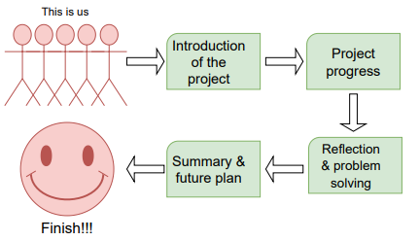
Table of content

Slide 3
1.1 About the Client 1.2 About the project 1.3 Background Research
1.4 Team member
1.Introduction
We are here
We are here

Slide 4
1.1 About our Client
Introduction of Cinefly
Media-tech company
Expecting to be an advanced patented storytelling and file platform.
Sharing these videos to influence society, tackling global issues.

Slide 5
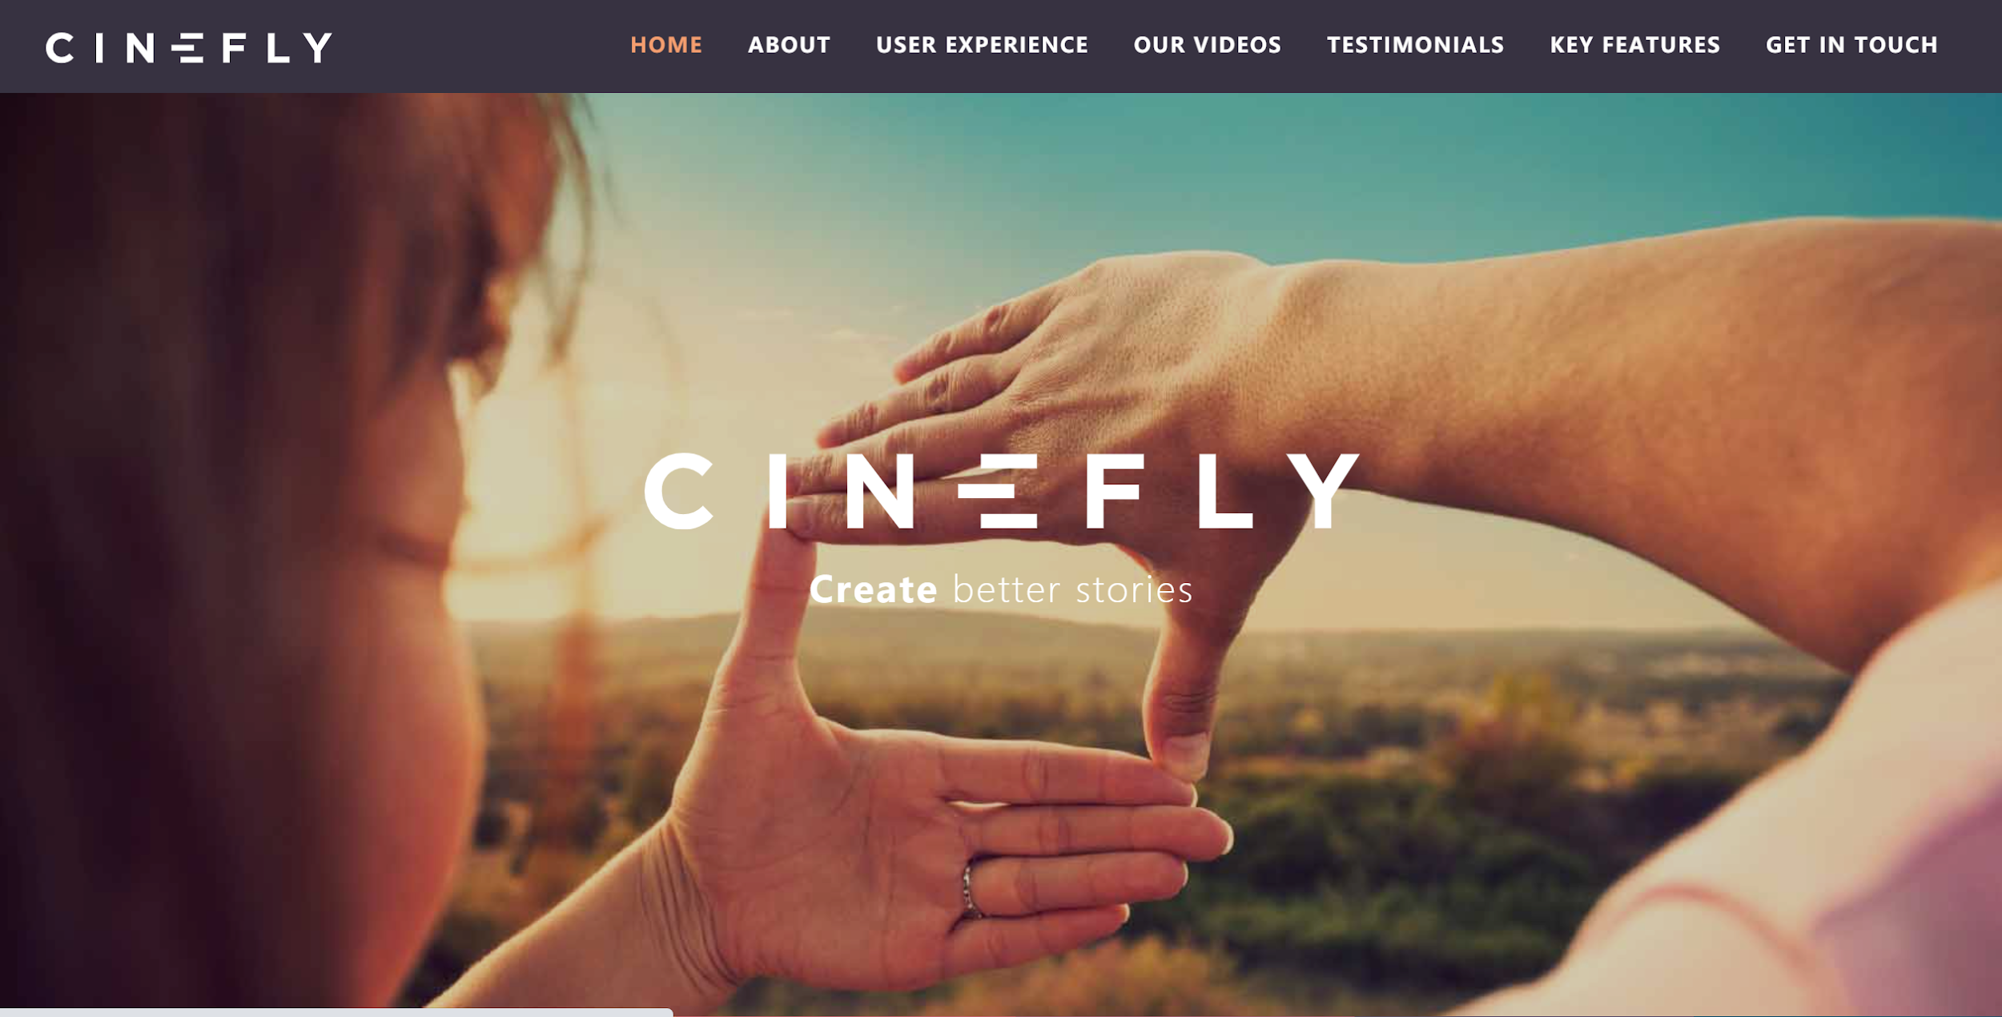
The problem or challenge
Please explain the question or problem that you investigated

Slide 6
1.2 About our Project
Project goal:
Developing a video classification algorithm.
The algorithm should be able to extract information from videos.

Slide 7

1.3 Background Research
Stakeholder Analysis
Our project stakeholders consist of 4 groups:
Client
Customers of Cinefly
Sponsors of Cinefly
Directors.

Slide 8
1.3 Background Research
Business Model of Cinefly
The Cinefly is an app/website which can help video creators to create new videos. The company hired some professional directors to design and develop storyboards which can be used by video creators.
The method of making profit for the company is selling those storyboards to the video creators, so that they can improve the quality of their work.

Slide 9
1.3 Background Research
Competitor Analysis
As a startup company with a unique and novel business model, it is difficult to find highly similar competitors in the market. Here, the team selected Tok-tok’s products to compare with Cinefly App:
The profit model is different.
The video content on the platform is different.

Slide 10
1.4 Team Member
Name | Skill
Jiawei Fan | Python, Machine learning algorithm, Java script, Database
Yuliang Ma | Machine learning algorithm, Database, Java Script, python
Yuchen Wang | Database, Java script, Machine learning algorithm, Python
Xiaoxiang Kong | Java, Database, Python, PPT
Yimin Xu | Java, Database, Python

Slide 11
2.1 Overview(based on timeline) 2.2 Project Management Progress 2.3 Technical Progress
2. Progress and achievements
We are here

Slide 12

2.1 SCHEDULE TIMELINE
Do some research regarding the algorithms mentioned in flow chart; Start coding
Fix and update our repository based on the feedback and client’s reply
Team charter confirmation
Week 2
Week 4
Week 6
Week 1
Week 3
Week 5
Team formalization and ice break
Establish communication with the client;
Create project repository
Determine the core flow chart of the algorithm

Slide 13
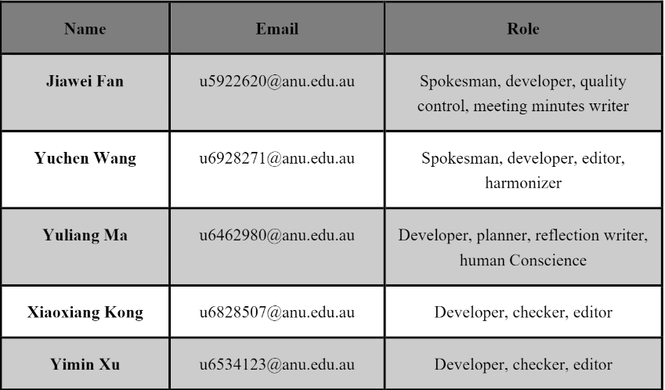

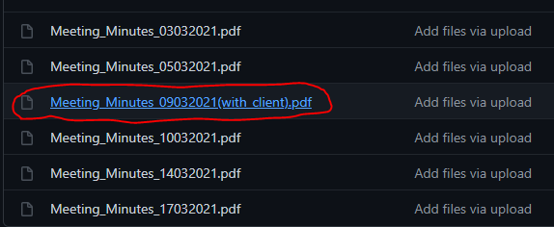

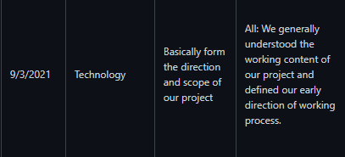
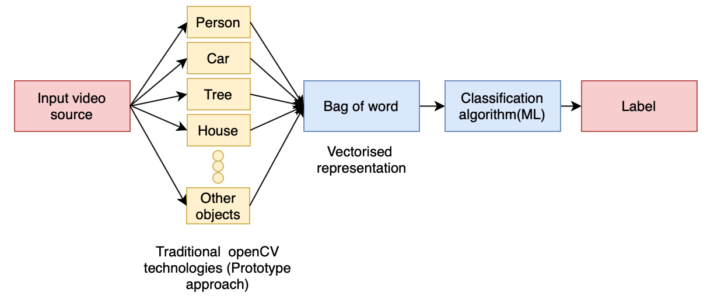
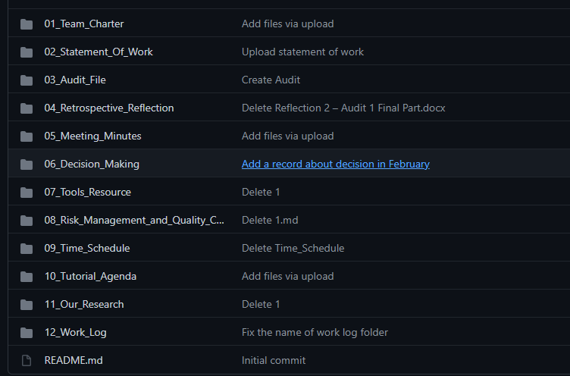
Primary Achievements
s
Week | Achievements
1
2
3
4
5
6
Team members contacted and build daily communication group
*concrete relevant content is in folder: 02_Statement_Of_Work
Got in touch with our client; Completed related market research; Team charter
Requirements summarization; Perfected our repository
Obtained technical material; Determined scope and direction of the project
Constructed flow chart and critical steps of the algorithm
Do research; Design relative models; Coding
All materials and screenshots are from our project repository: https://github.com/ch4ser/21-S1-2-C-Cinema/

Slide 14
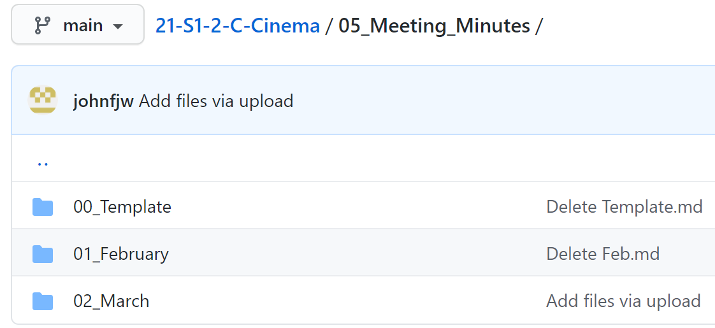
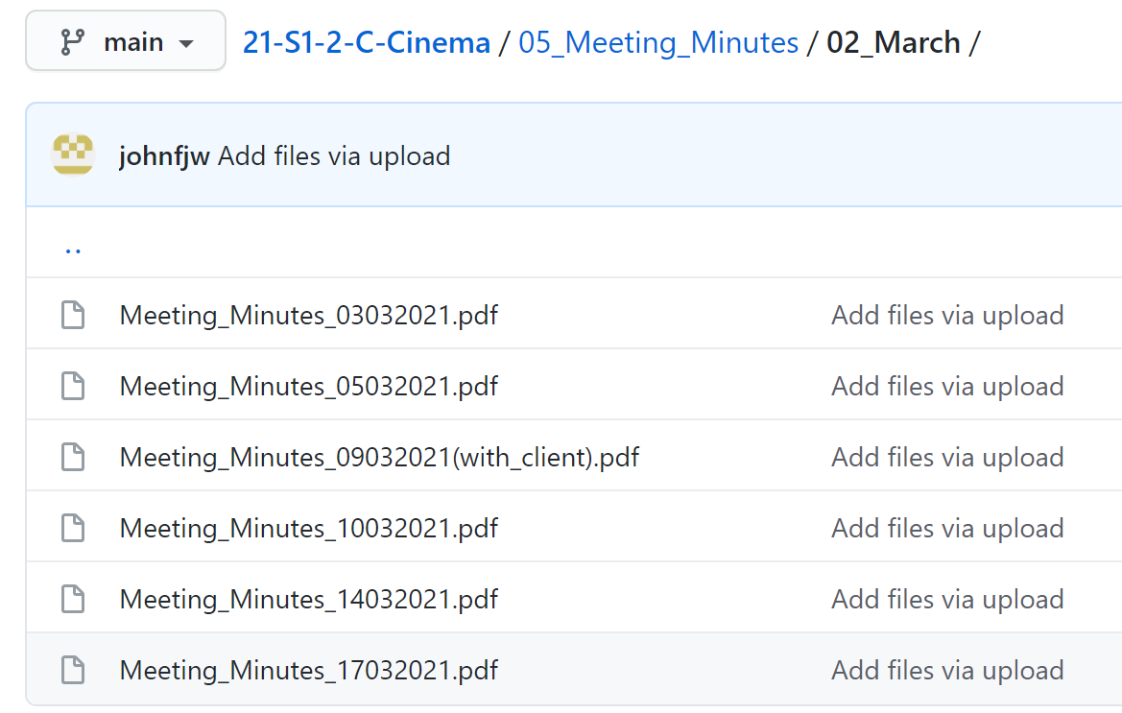
Meeting Minutes
Github Link: https://github.com/ch4ser/21-S1-2-C-Cinema/tree/main/05_Meeting_Minutes

Slide 15
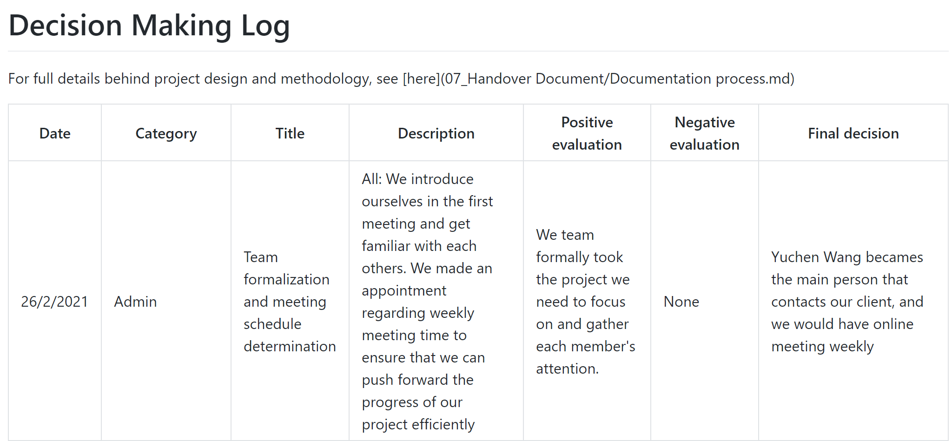
Decision Log
Github Link: https://github.com/ch4ser/21-S1-2-C-Cinema/blob/main/06_Decision_Making/Decision_logs.md

Slide 16
2.2 Project management progress
Progress:
2.2.1 Team charter
2.2.2 Client engagement

Slide 17
1. Respect each other.
2. Minority obedience to majority.
3. Penalty on contribution if not participating in .
2.2.1 Team Charter
Ground rules

Slide 18
1. Internal meetings
2. Client meetings
3. Tutorial consultation meetings
2.2.1 Team Charter
Communication norms

Slide 19
Task progress synchronization and planning for future work.
Reflection meeting.
2.2.1 Team Charter
Internal meetings

Slide 20
This meeting should be held at least once per week.
The format of conference can be face to face, online meeting via zoom.
Reporting the latest project progress.
2.2.1 Team Charter
Client meetings

Slide 21
Monitoring the progress and quality of the project
Reporting the progress of the project to the tutors and obtained tutors’ suggestions and help if we encounter obstacles.
2.2.1 Team Charter
Tutorial consultation meeting

Slide 22
Client communication norms
Problems and solutions
2.2.2 client engagement
Communication norms

Slide 23
2.3 Technical progress
Progress:
2.3.1 Project goal review
2.3.2 Researches
2.3.3 Algorithm design
2.3.4 Implemented outputs

Slide 24
Object: Algorithm
Function: Classification, labelization.
Language: Python
Fields: Computer vision, machine learning
2.3.1 Project goal review

Slide 25
Traditional video classification algorithms: HOG、HOF、MBH, Bag of words, k-means and logistic regression
Video classification algorithms based on deep learning: CNN, NetVLAD, Inception-Resnet v2, MLP(classifier)
2.3.2 Research & literature Review
Szegedy C, Ioffe S, Vanhoucke V, et al. Inception-v4, inception-resnet and the impact of residual connections on learning[C]//Thirty-First AAAI Conference on Artificial Intelligence. 2017.
Arandjelovic R, Gronat P, Torii A, et al. NetVLAD: CNN architecture for weakly supervised place recognition[C]//Proceedings of the IEEE conference on computer vision and pattern recognition. 2016: 5297-5307.
Arandjelovic R, Gronat P, Torii A, et al. NetVLAD: CNN architecture for weakly supervised place recognition[C]//Proceedings of the IEEE conference on computer vision and pattern recognition. 2016: 5297-5307.

Slide 26
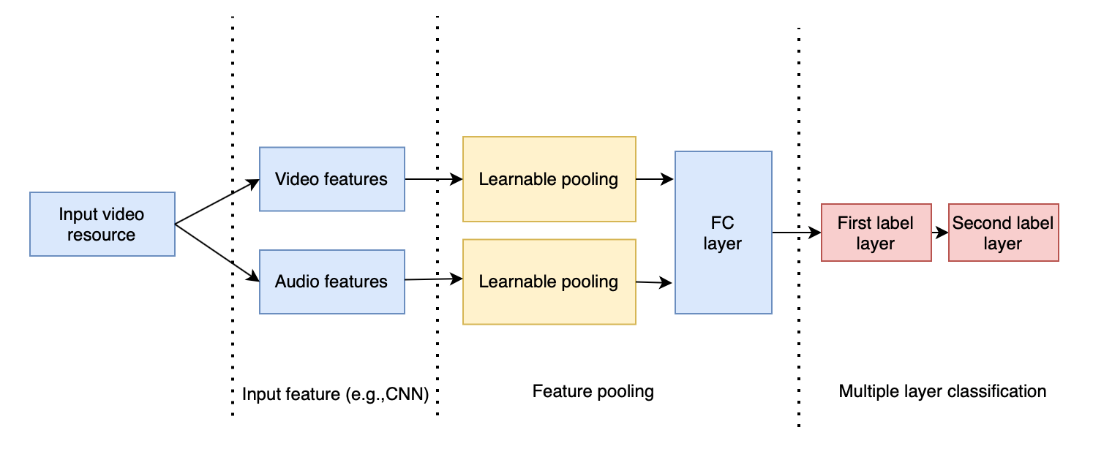
2.3.3 Algorithm Design
Video classification algorithms based on deep learning

Slide 27

2.3.3 Algorithm Design
(2) Traditional video classification algorithms

Slide 28
2.3.4 Some implemented outputs
Demo using traditional video classification algorithms

Slide 29
3.1 Output 3.2 Decision Making 3.3 Teamwork
3.4 Communication
3. Reflection
We are here

Slide 30
We have solved:
Landing page is too wordy and lacking intuitive charts and graphs.
Inadequate consideration of risk management.
Lack of timeline, project deliverable and competitor analysis
3.1 Reflection
Output

Slide 31
We have solved:
Lacking of record of decision making.
Fuzzy decision making process.
3.2 Reflection
Decision Making

Slide 32
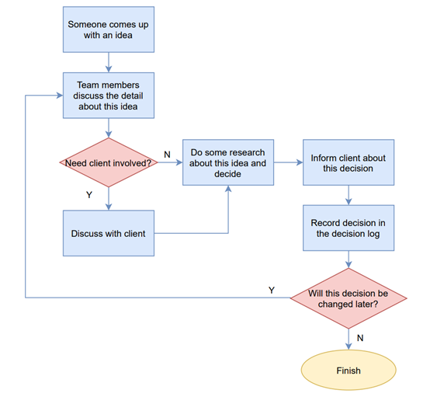
Flow diagram of Decision Making

Slide 33
We have solved:
Lacking of record of teamwork(task assignment and communication between team members).
Weekly meeting time and frequency are not clear.
3.2 Reflection
Teamwork

Slide 34
We have solved:
Lacking of record of communication with the client.
The meeting time with the client is not clear.
The tools of communicating with the client is not clear.
3.2 Reflection
Communication

Slide 35
4.1 Summary 4.2 Future Plan
4. Summary and future plan
We are here

Slide 36

What will we do next?
Start to code!!
Hope we can up to the deep learning algorithm development stage!

Slide 37
Thank you all for listening!
Feel free to ask any questions.

